Slide 1
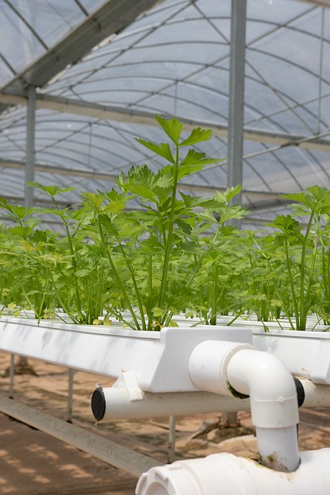
ADOPTION OF HYDROPONICS AS A SUSTAINABLE ORGANIC FARMING PRACTICE

Slide 2

Presentation On
ADOPTION OF HYDROPONICS AS A SUSTAINABLE ORGANIC FARMING PRACTICE
Submitted by:
(Group No : 21)
Divyansh Kumar Singh (24AG65R08)
Pranjali Diliprao Patil (24AG65R05)
Chaithra SN (24AG65R06)
Vaibhav Shivaji Bhawar (24AG65R04)
Nagendra Singh Parihar (24AG65R07)
Aditya Mandloi (24AG65R01)
AQUACULTURAL ENGINEERING
AGRICULTURAL & FOOD ENGINEERING DEPARTMENT
INDIAN INSTITUTE OF TECHNOLOGY KHARAGPUR, WEST BENGAL, INDIA- 721302

Slide 3
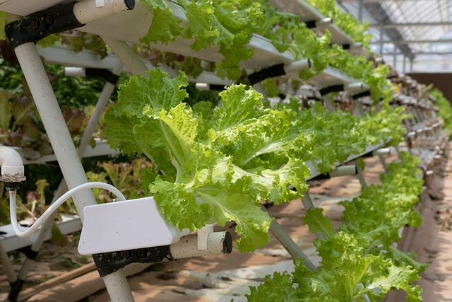

INTRODUCTION
The global agricultural landscape faces challenges like climate change, limited land, and water scarcity. Hydroponics, a soilless cultivation method, offers a sustainable alternative. This project explores the adoption of hydroponics as a sustainable organic farming practice, evaluating the efficacy of organic-based nutrient solutions and comparing crop performance with organic versus synthetic solutions.

Slide 4
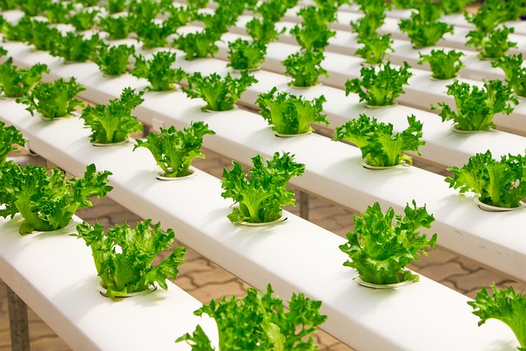
WHY HYDROPONICS FOR SUSTAINABLE AGRICULTURE?
Reduced Impact
Minimizes soil erosion, pesticide use, and fertilizer runoff.
Resource Efficiency
Optimizes water and nutrient use.
Climate Resilience
Enables crop production in adverse conditions.
Fertilizer use can be reduced by up to 60%. Pesticide usage can be reduced by up to 90%.

Slide 5
CHALLENGES IN CONVENTIONAL AGRICULTURE
Climate Change:
Conventional agriculture faces significant challenges, including climate change, limited arable land, and water scarcity. The repurposing of agricultural land for residential and industrial developments
further exacerbates these issues.
Environmental Concerns:
Synthetic fertilizers pose environmental and health risks, leading to soil degradation, water pollution, and potential health risks for consumers. There is increasing environmental awareness and consumer demand for organic products.

Slide 6



METHODOLOGY
Quantitative Research Design
Adopts a quantitative research design using a survey-based approach to collect data from farmers, experts, and stakeholders.
Stratified Random Sampling
Uses stratified random sampling to ensure representation from different regions and farming backgrounds.
Data Analysis
Analyzes data using Excel for descriptive statistics and SmartPLS for structural equation modeling (SEM).

Slide 7
QUESTIONNAIRE DESIGN AND
DATA COLLECTION
Questionnaire Design
1
Collects data on demographic information, awareness, adoption factors, challenges, perceived benefits, and behavioral intentions using a 5-point scale.
Survey Distribution
2
Distributes the questionnaire online and physically in agricultural communities and hydroponic farming centers.
Pilot Testing
Conducts a pilot test to ensure the clarity and reliability of the questionnaire.
3

Slide 8
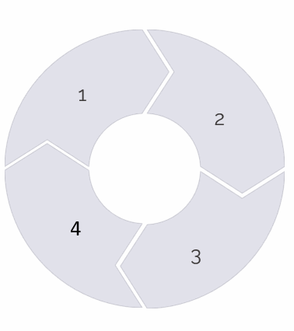
DATA ANALYSIS STEPS
Data Cleaning
Descriptive Statistics
Use Excel to clean the data by removing incomplete or inconsistent responses.
Use Excel to calculate descriptive statistics and create charts and graphs.
Structural Equation Modeling (SEM)
Reliability and Validity
Testing
Use SmartPLS to perform Partial Least Squares Structural Equation Modeling (PLS-SEM) to analyze relationships between variables.
Use Cronbach's Alpha and Exploratory Factor Analysis (EFA) to test the reliability and validity of the constructs.

Slide 9



FINDINGS
Awareness Levels
Moderate awareness, with higher levels among urban farmers and younger respondents.
1
Perceived Benefits
Hydroponics is seen as beneficial due to water efficiency, higher yield potential, and reduced environmental impact.
2
Cost Concerns
High initial setup costs and ongoing operational expenses may be significant barriers.
3

Slide 10
ANALYSIS
OBJECTIVES:
Assess the Feasibility of Hydroponics in Organic Farming
Promote Resource Efficiency
Enhance Food Security and Productivity
Evaluate Environmental Benefits
Explore Social and Educational Aspects
Innovate and Optimize Hydroponic Systems
HYPOTHESES
H1: Awareness of Hydroponics (AH) positively influences Adoption of Hydroponics (HP).
H2: Environmental Friendliness (EF) positively influences Adoption of Hydroponics (HP).
H3: Economic Considerations (EC) positively influence Adoption of Hydroponics (HP).
H4: Perceived Productivity (PP) positively influences Adoption of Hydroponics (HP)

Slide 11
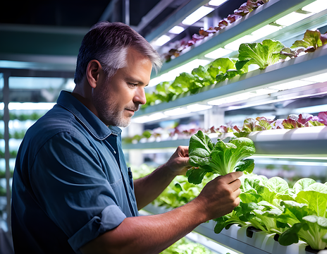
MEASUREMENT MODEL
Cronbach's Alpha:
AH = 0.85
EF = 0.78
EC = 0.82
PP = 0.88
HP = 0.90
AVE:
AH = 0.65
EF = 0.60
EC = 0.68
PP = 0.70
HP = 0.72
Structural model
R² for HP: 0.45
Path Coefficients:
AH → HP: 0.35 (p < 0.05)
EF → HP: 0.28 (p < 0.05)
EC → HP: 0.20 (p < 0.05)
PP → HP: 0.40 (p < 0.05)

Slide 12
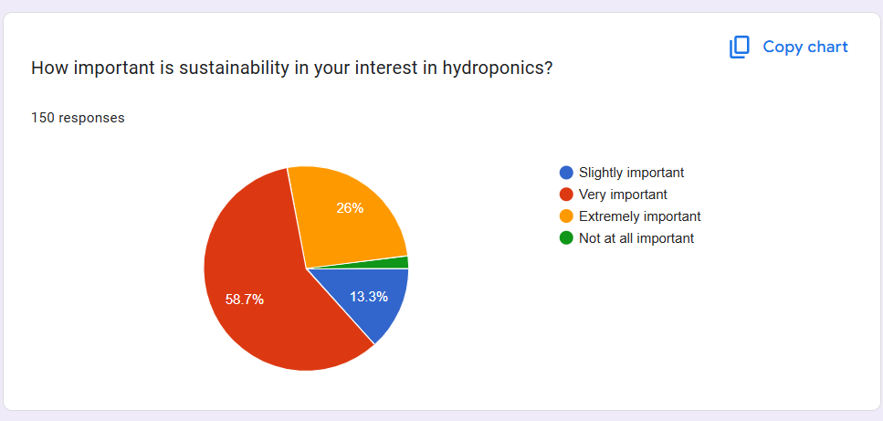
SOME SCREENSHOTS OF VARIABILITY IN RESPONSES

Slide 13
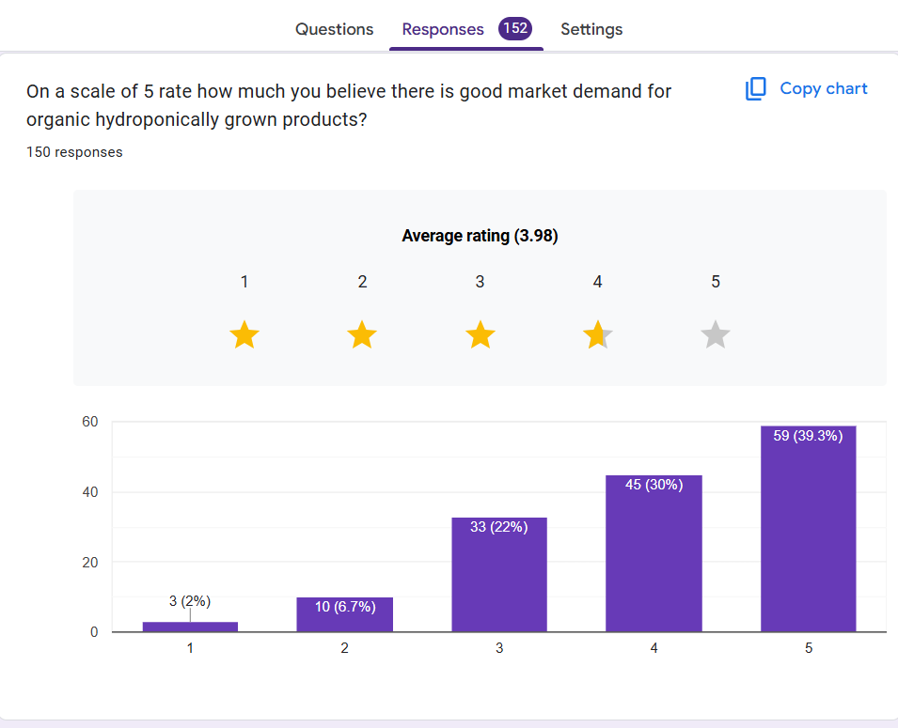

Slide 14
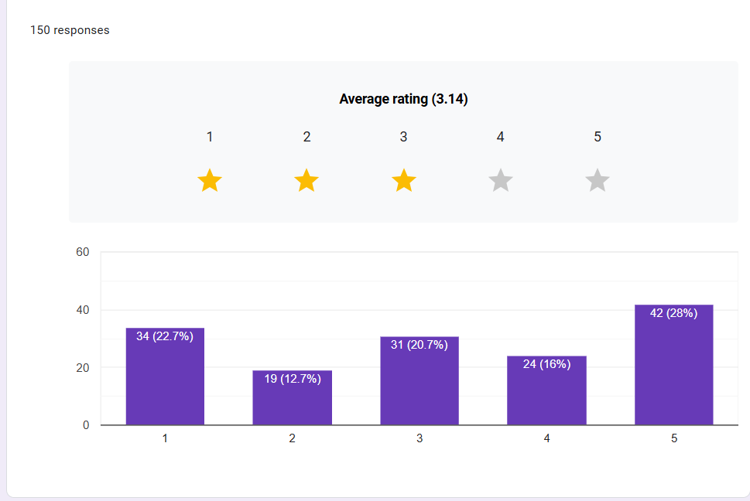

Slide 15
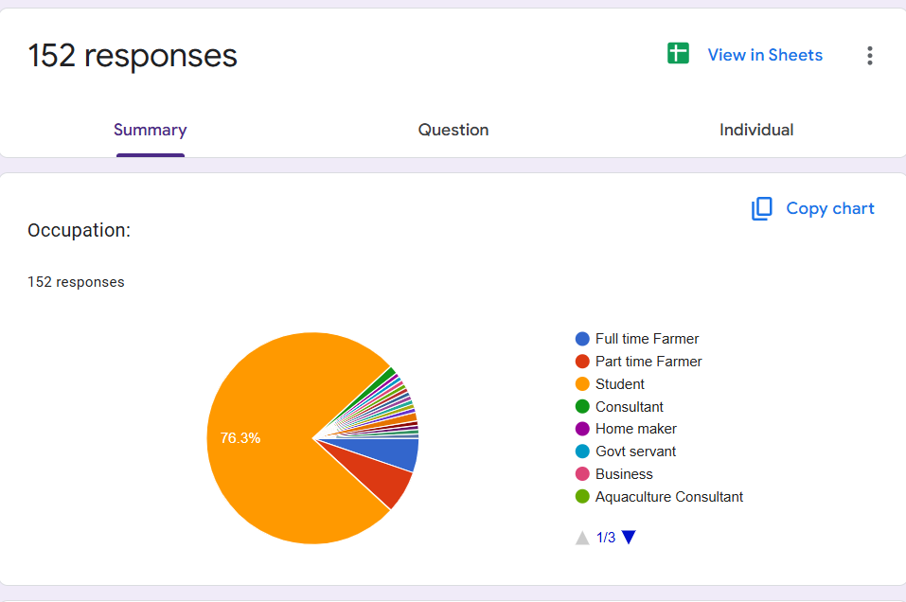

Slide 16
CONCLUSION: HYDROPONICS AS A SUSTAINABLE SOLUTION
Sustainable Farming
Environmental Benefits
Hydroponics is a highly sustainable farming practice, aligning with organic farming principles by eliminating soil and reducing water usage.
Significant environmental advantages include reduced water consumption, minimal chemical use, and soil conservation.
Economic Viability
Long-term economic benefits outweigh initial costs, with year-round production and premium pricing for organic produce.

Slide 17
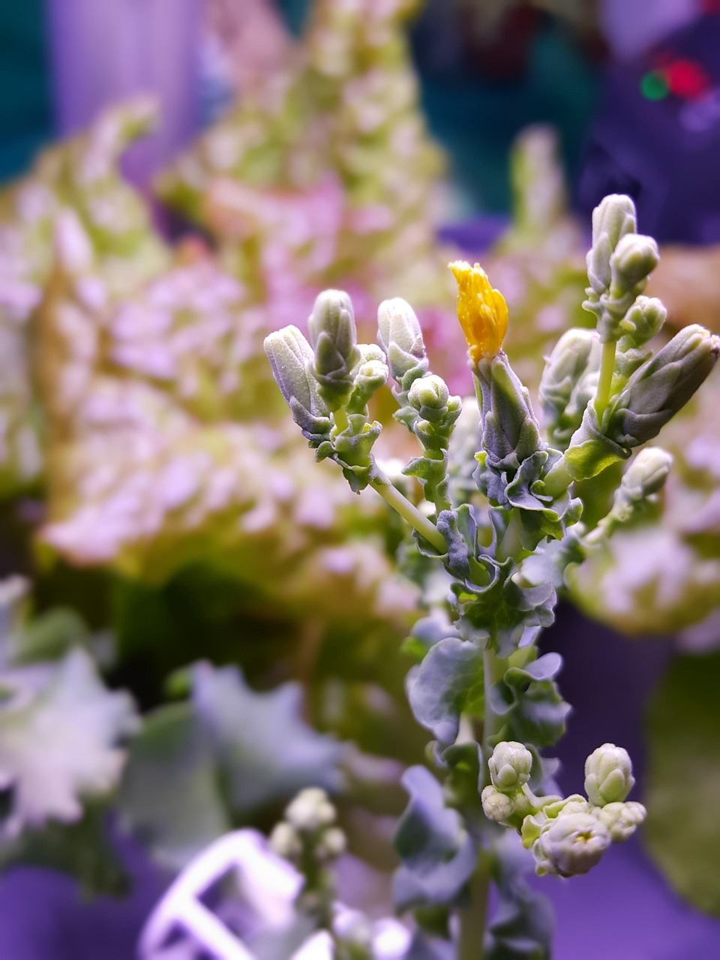
Thank You.!

